Slide 1


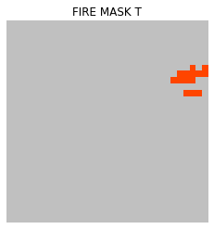
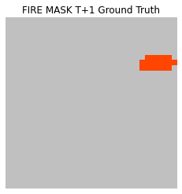
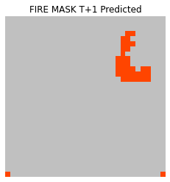
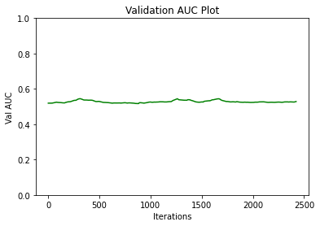
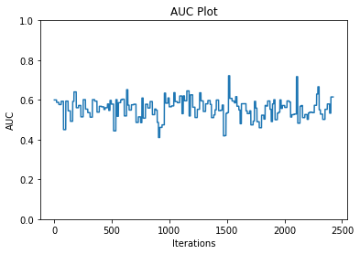
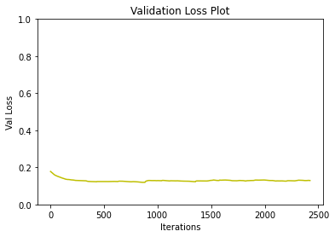
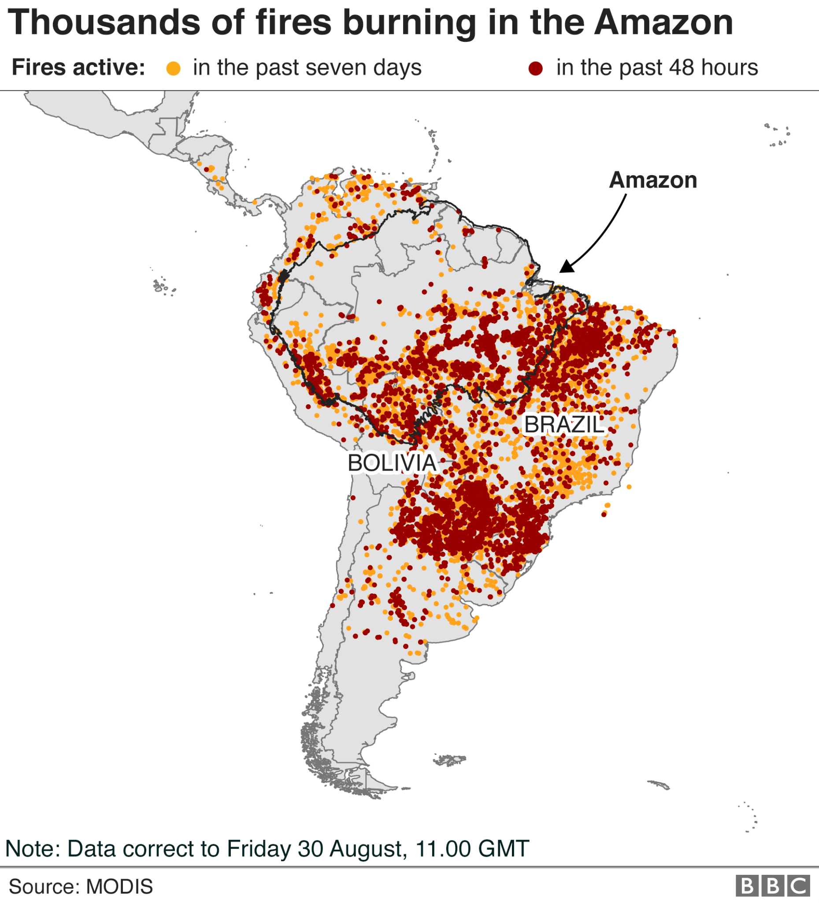
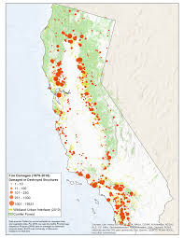
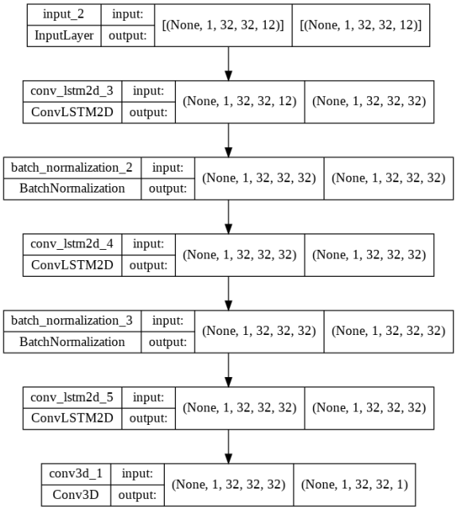
Global Wildfire Spread Prediction Utilizing Granuralized Remote Sensing Feature Sets
Syed Ali ² , Ali Khan ², Anish Goel ¹, Aditya Singirikonda ¹, Swetha Kambathula ², Bhavitha Velaga ², Ting Xiao ³
¹ Texas Academy of Math and Science, ² University of North Texas, ³ Department of Computer Science and Engineering
Abstract
Results
Natural catastrophe modeling allows for the evaluation, and management of economic loss, property loss, and loss of life during and after such an event. In this project, we examine the challenges of curating large-scale multivariate datasets produced from heterogeneous sources of remote sensing environmental spatiotemporal data. Unlike existing datasets that are tailored to a specific task, multiple variables such as local topography, climate, and population density affect the impact of a natural disaster on a community. We highlight commonalities across natural catastrophes and provide a framework for generating datasets targeted to a particular catastrophe for deep learning. We expect that these datasets can be utilized to produce state-of -the-art results in disaster prediction and modeling.
Algorithm
Harm and Motivation
From 2012 to 2021, there were an average of 61,289 wildfires annually and an average of 7.4 million acres impacted annually. In 2021, 58,968 wildfires burned 7.1 million acres. As of June 1, 2022, over 27,800 wildfires have impacted about 1.9 million acres this year.
Wildfires and volcanic activities affected 6.2 million people between 1998-2017 with 2400 via suffocation, injuries, and burns and loss of housing or loss of property.
The aim of our model is to prevent loss of life with the utilization of a next day wildfire plot, reduce economic damage by informing insurance companies about the possible spread of the fire, and lastly prevent property damage in affected areas.
Fig 5: Validation AUC graph displaying accuracy of current model
Fig 5: AUC graph displaying accuracy of current model
Fig 6: Loss graph displaying loss for our current model
Methods
Conclusion
Utilized a Convolutional LSTM model to take in multiple pieces of input data such as previous fire masks, vegetation, and temperature and output ann AUC value that displayed the accuracy of the model
We also implemented data visualization to show user the next day prediction of the wildfire based on input data from the data set.
Our model needs more tuning and has vast room for improvement with some dataset and hyperparameter tuning.
Our model had better performance than previous models utilizing the same dataset. We were able to come to this conclusion due to our models higher AUC score which was the metric used in the last paper. Our AUC was calculated to be 216% more accurate than the previous efforts AUC score.
We hope to continue making improvements in the models via fine tuning and hyperparameter tuning, so we can improve accuracy and allow for the model to be useful in real life situations.
References
Fantine Huot, R. Lily Hu, Nita Goyal, Tharun Sankar, Matthias Ihme, and Yi-Fan Chen “Next Day Wildﬁre Spread: A Machine Learning Data Set to Predict Wildﬁre Spreading from Remote-Sensing Data”
Fig 1: Wildfire Spread in South America.
Fig 2: Long Term Trends in Wildfire Damage in California
Fig 3: diagram of convolutional LSTM model for our project.

